Slide 1


Tabular Data Analysis
2025. 12. 03.
JangHoon Chun
Department of Medical Device Industry,
Gangnam Severance Hospital,
Yonsei University College of Medicine

Slide 2
What’s discussed in the last meetings
인체 임상 변수
영상 파생 변수
Variable | Description | Units / Classification
File Analyzed | 환자 / 케이스 식별자 | ID
Osteoporosis | 골다공증 여부 (0=정상, 1=골다공증) | Binary
Age | 나이 | 세
진료년월일 | 검사 날짜 | YYYY-MM-DD
키 | 키 | cm
체중 | 몸무게 | kg
BMI | 체질량지수 | kg/m²
허리둘레 | 허리 둘레 | cm
근육량SoftLeanMass | 부위별 평균 근육량 | kg
체지방율BodyFat | 체지방 비율 | %
체지방량FatMassKg | 체지방 총량 | kg
복부지방율WHRatio | 복부지방률 (WH Ratio) | %
복부내장지방량 | 내장지방량 | kg
복부피하지방량 | 피하지방량 | kg
초경연령ALL | 초경 시작 나이 | 세
폐경여부 | 폐경 여부 (1=예, 0=아니오) | Binary
출산횟수ALL | 출산 횟수 | Count
Variable | Description | Units / Classification
BreastArea(sqcm)AVG | 유방 전체 면적 평균 | cm²
DenseArea(sqcm)AVG | 치밀 조직 면적 평균 | cm²
BreastDensity(%)AVG | 유방 내 치밀조직 비율 | %
Breast_Density_Grading | 유방 밀도 등급 (1~4단계) | Categorical
BIRADS_Category | BI-RADS 평가 카테고리 | 1~5 등급
Group | Samples
Total | 3,961(100)
Normal | 3,475(87.7)
Osteoporosis | 486(12.3)

Slide 3
What’s discussed in the last meetings
Variable | Classification | N_Sample | mean | std | min | 25% | 50% | 75% | max
Age | Total | 3,961 | 60.3 | 7.34 | 36 | 55 | 59 | 65 | 90
 | Normal(0) | 3,475 | 59.81 | 7.07 | 36 | 55 | 59 | 64 | 86
 | Osteoporosis(1) | 486 | 63.78 | 8.18 | 48 | 58 | 62 | 69 | 90
BMI | Total | 3,961 | 23.07 | 3.12 | 12.5 | 20.9 | 22.7 | 24.8 | 42.2
 | Normal(0) | 3,475 | 23.21 | 3.12 | 12.5 | 21.1 | 22.9 | 24.9 | 42.2
 | Osteoporosis(1) | 486 | 22.07 | 2.99 | 14.3 | 20.1 | 21.8 | 24.0 | 38.1
BreastDensity(%)AVG | Total | 3,961 | 26.75 | 11.45 | 3.13 | 19.26 | 24.81 | 32.28 | 89.30
 | Normal(0) | 3,475 | 26.59 | 11.24 | 3.13 | 19.18 | 24.78 | 32.15 | 89.30
 | Osteoporosis(1) | 486 | 27.87 | 12.81 | 5.12 | 19.78 | 24.96 | 33.53 | 84.95
BreastArea(sqcm)AVG | Total | 3,961 | 122.54 | 38.10 | 27.45 | 95.33 | 117.25 | 144.23 | 377.72
 | Normal(0) | 3,475 | 123.57 | 38.38 | 27.45 | 96.75 | 118.56 | 145.10 | 377.72
 | Osteoporosis(1) | 486 | 115.22 | 35.22 | 31.55 | 88.61 | 110.13 | 137.10 | 241.37
DenseArea(sqcm)AVG | Total | 3,961 | 29.73 | 10.59 | 9.35 | 22.49 | 27.81 | 34.68 | 97.78
 | Normal(0) | 3,475 | 29.87 | 10.71 | 9.35 | 22.56 | 27.90 | 34.80 | 97.78
 | Osteoporosis(1) | 486 | 28.68 | 9.58 | 10.04 | 21.72 | 27.01 | 33.87 | 66.51
Type | Age | BMI | BreastDensity(%)AVG | BreastArea(sqcm)AVG | DenseArea(sqcm)AVG
t-stat | -10.18 | 7.86 | -2.09 | 4.84 | 2.53
p-value | <0.001 | <0.001 | 0.037 | <0.001 | 0.012

Slide 4
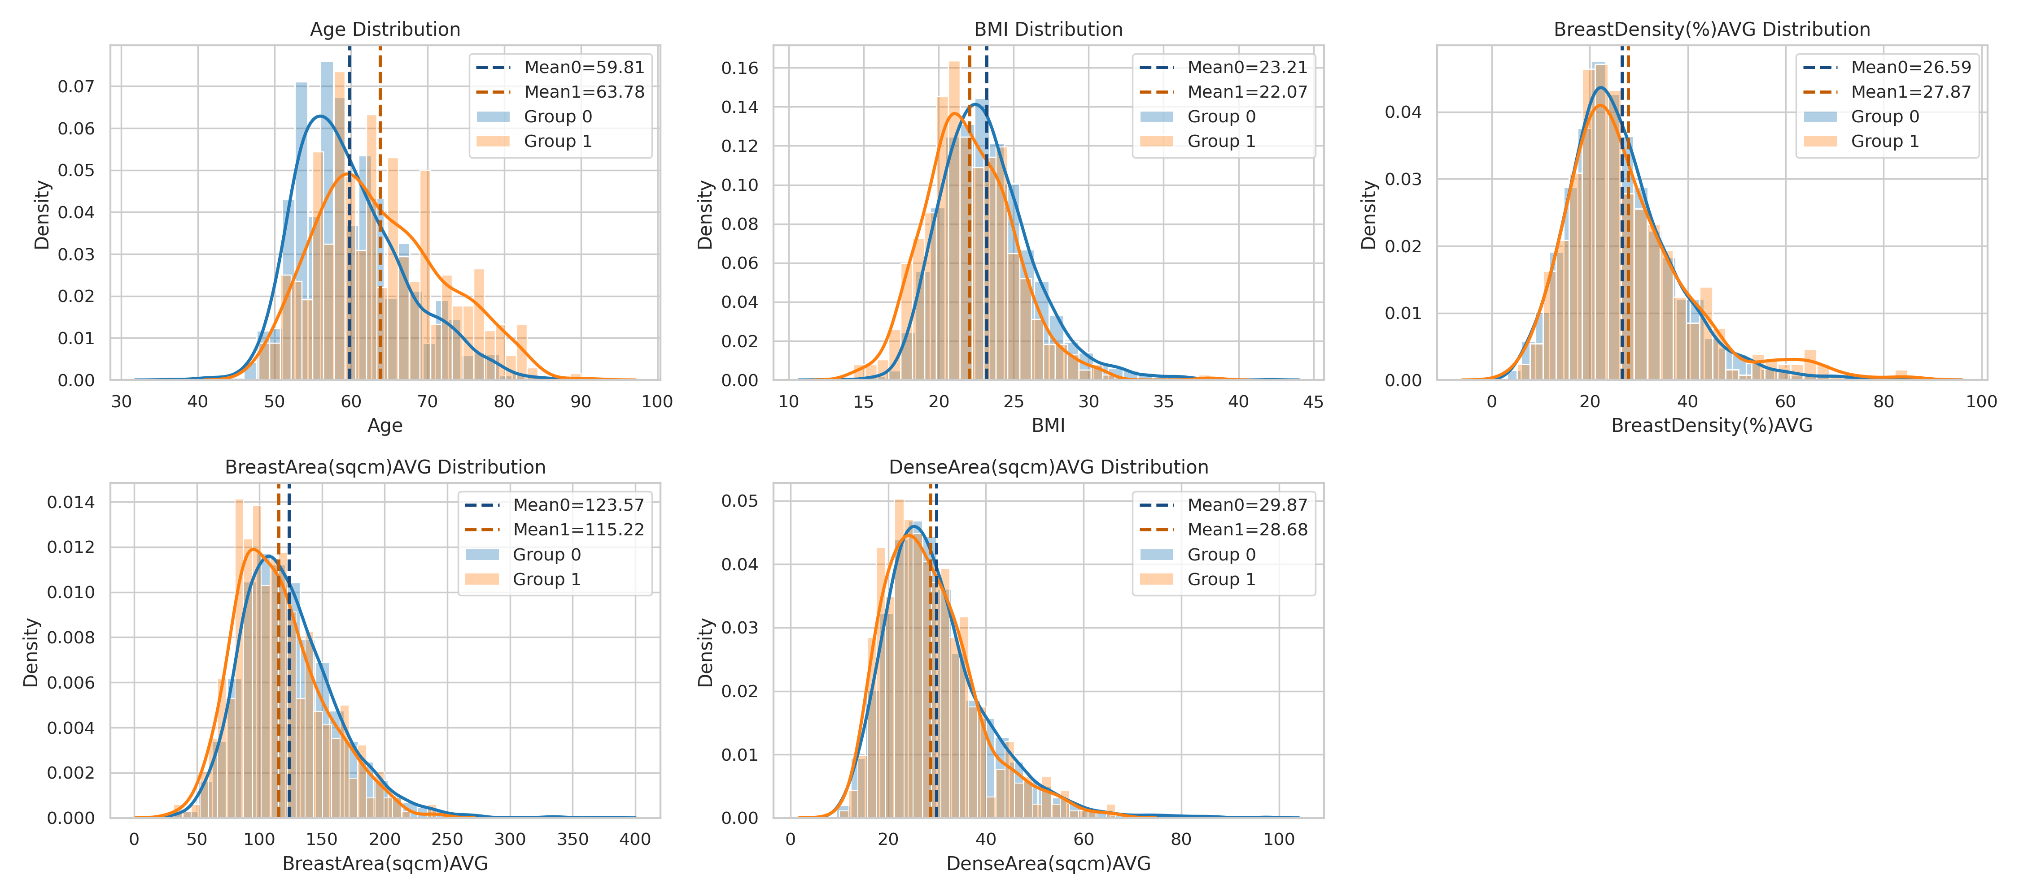
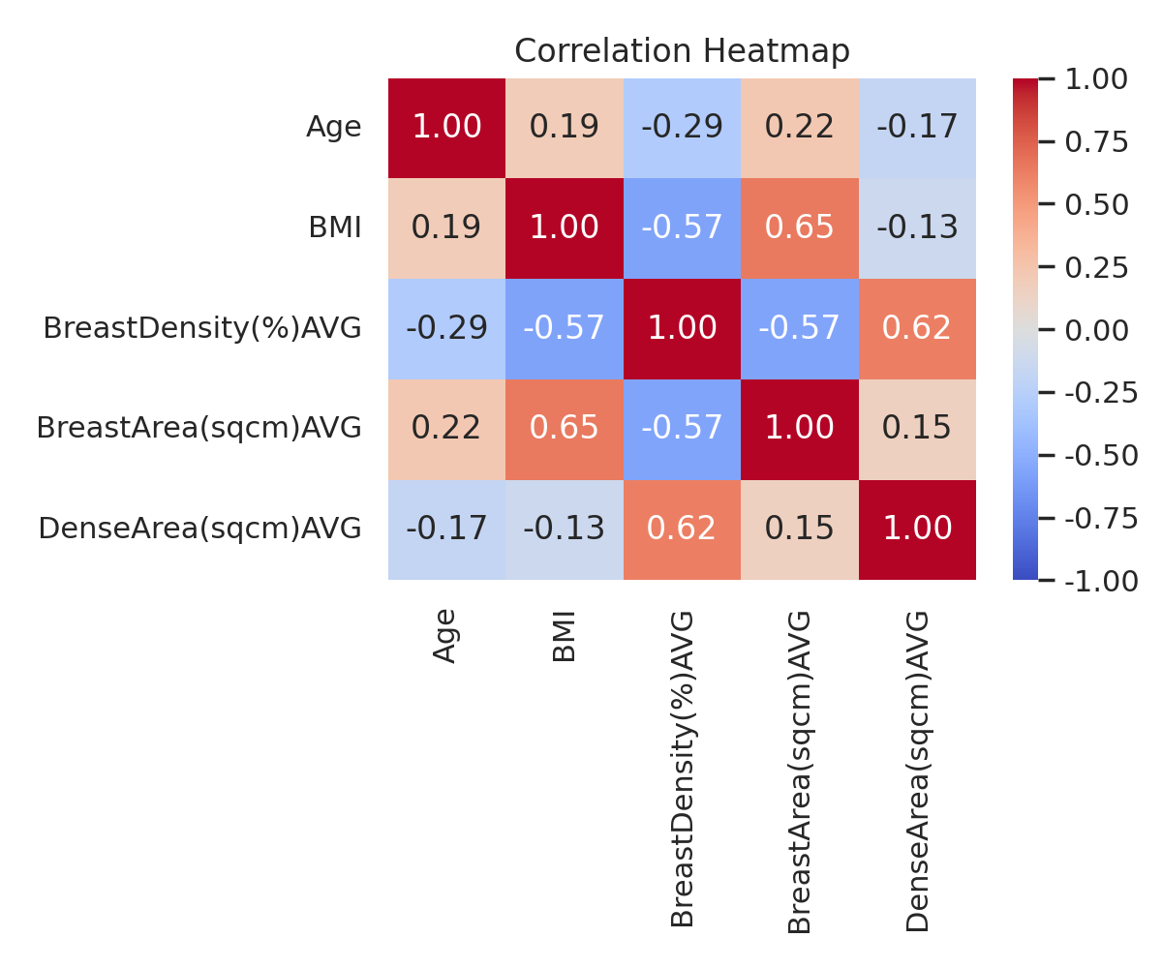
What’s discussed in the last meetings

Slide 5
Research Summary
Developed a Logistic Regression baseline using a postmenopausal cohort of 3,961 subjects.
Age, BMI, BreastDensity, and DenseArea showed significant group differences.
Holdout and k-fold CV delivered similar performance, indicating stable data behavior.
SMOTE and undersampling had minimal impact on AUC and accuracy.
GridSearch yielded a Precision 1.0 / Recall 0.01 issue, requiring further threshold and sampling analysis.
Stratified results showed clear sensitivity differences across Age, BMI, and BDG (AUC higher in BDG 2 and 4).
Logistic Regression achieved ~0.71 AUC, providing a reliable baseline for future model upgrades.

Slide 6
Research Summary
Postmenopausal Cohort Analysis (Logistic Regression)
Age, BMI, BreastDensity, DenseArea 등이 linear한 경향이 있다고 생각
해석 가능성과 낮은 데이터 요구량에 기반한 Baseline 구축
의료 Tabular 데이터의 선형적 구조와 높은 적합성
Data Augmentation
oversampling with y=1 with SMOTE method
SMOTE: Synthetic Minority Over-sampling Technique
undersampling with y=1 with RandomUnderSampler

Slide 7
Research Summary
Compared Holdout vs. k-fold Cross-Validation → similar performance across all metrics
Conducted hyperparameter tuning via Grid Search (param_grid)
Higher performance with lower precision code improvements leads to lower Recall
Performed stratified analyses using Age, BMI, BDG
Age: the older the age, the higher the recall
BMI: the lower the number, the higher the recall
BDG: in Grade 2, recall is highest

Slide 8
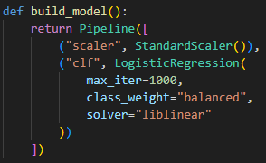
Detailed Progress
Dataset Split
폐경군 Total 3961개에 대해서 8:2로 Train:Test로 Dataset Split 진행
Train Dataset : 3168(2779/389), Test Dataset : 793(696/97), scale_pos_weight=7.144
stratify 옵션을 사용하여 Dataset 비율 유지
Pipeline

Slide 9
Detailed Progress
Logistic Regression Results
Test Metrics : 793 [696 / 97]
SMOTE | Test Metrics : 793 [696 / 97]
Feature Set | Accuracy | Precision | Recall | F1 | AUC
[age, bmi] | .6595 | .2164 | .6804 | .3284 | .7144
[age, bmi, bda] | .6507 | .2097 | .6701 | .3194 | .7105
[age, bmi, bdg] | .6608 | .2171 | .6804 | .3292 | .7146
[age, bmi, da] | .6545 | .2117 | .6701 | .3218 | .7051
Feature Set | Accuracy | Precision | Recall | F1 | AUC
[age, bmi] | .6608 | .2171 | .6804 | .3292 | .7148
[age, bmi, bda] | .6545 | .2136 | .6804 | .3251 | .7106
[age, bmi, bdg] | .6633 | .2167 | .6701 | .3275 | .7114
[age, bmi, da] | .6507 | .2078 | .6598 | .316 | .7066

Slide 10
Detailed Progress
Logistic Regression Results
Test Metrics : 793 [696 / 97]
UnderSampling | Test Metrics : 793 [696 / 97]
Feature Set | Accuracy | Precision | Recall | F1 | AUC
[age, bmi] | .6595 | .2164 | .6804 | .3284 | .7144
[age, bmi, bda] | .6507 | .2097 | .6701 | .3194 | .7105
[age, bmi, bdg] | .6608 | .2171 | .6804 | .3292 | .7146
[age, bmi, da] | .6545 | .2117 | .6701 | .3218 | .7051
Feature Set | Accuracy | Precision | Recall | F1 | AUC
[age, bmi] | .6456 | .2089 | .6804 | .3196 | .7146
[age, bmi, bda] | .6431 | .2075 | .6804 | .3181 | .7124
[age, bmi, bdg] | .6419 | .2123 | .7113 | .3270 | .7138
[age, bmi, da] | .6494 | .2109 | .6804 | .3220 | .7060

Slide 11
Detailed Progress
LogisticRegression Hyperparameter
penalty: l2 (default)
정규화 유형. 선택지: `None`, `'l1'`, `'l2'`, `'elasticnet'`.
효과: 과적합 제어. `l1`은 희소(특징 선택) 유도. `elasticnet`은 L1+L2 혼합.
주의: 일부 solver와 호환성 제약 있음(예: `elasticnet`은 `saga`만).
dual: False (default)
듀얼 문제 사용 여부.
사용처: `liblinear`에서만 의미 있음. 보통 `n_samples > n_features`면 `dual=False` 권장.
tol: 1e-4 (default)
수렴 판정 허용 오차(작을수록 정밀도 ↑, 계산량 ↑).
C: 1.0 (default)
규제 역수 (작을수록 규제 강도 ↑).
튜닝 추천: 로그 스케일 탐색 예: `np.logspace(-4, 4, 10)`.
fit_intercept: True (default)
절편 항 포함 여부.

Slide 12
Detailed Progress
LogisticRegression Hyperparameter
intercept_scaling: 1 (default)
`liblinear` 사용 시 절편 스케일 조정(보통 기본값 사용).
class_weight: None (default)
클래스 불균형 처리: `None`, `dict`, 또는 `'balanced'`.
random_state: None (default)
재현성(무작위 셔플 등).
영향: `sag`, `saga`, `liblinear` 등에서 데이터 셔플/초기화에 영향.
solver: lbfgs (default)
최적화 알고리즘 선택. 선택지: 'lbfgs', 'liblinear', 'newton-cg', 'newton-cholesky', 'sag', 'saga'.
중요한 호환성:
'liblinear'는 binary 전용(멀티클래스는 OvR).
'saga'는 elasticnet 지원.
일부 solver는 특정 penalty만 지원(예: 'lbfgs'는 l2 또는 None).
튜닝: 데이터 크기/희소성에 따라 선택 (liblinear 소규모, sag/saga 대규모).

Slide 13
Detailed Progress
LogisticRegression Hyperparameter
max_iter: 100 (default)
최대 반복 횟수(수렴하지 않으면 증가시킬 수 있음).
multi_class: (deprecated)
멀티클래스 전략: 'auto', 'ovr', 'multinomial'.
현재 버전에서는 일부 deprecation 경고 있음; 멀티클래스 사용 시 문서 확인 권장.
verbose: 0 (default)
학습 메시지 출력 레벨.
warm_start: False (default)
이전 학습 결과를 초기화값으로 재사용.
n_jobs: None (default)
병렬 처리에 사용할 CPU 수(일부 solver에만 영향).
l1_ratio: None (default)
elasticnet 혼합비 (0<=l1_ratio<=1). penalty='elasticnet'일 때 지정.

Slide 14
Detailed Progress
LogisticRegression Hyperparameter
penalty ↔ solver 호환성 반드시 확인: 예) elasticnet은 saga만, liblinear는 multinomial 지원 안 함.
규제 강도(C)는 log scale로 탐색. l1 또는 elasticnet 사용 시 특성 선택 효과 확인.
클래스 불균형 심하면 class_weight='balanced' 또는 sampling을 고려.
대용량 데이터는 sag/saga가 빠름(특성 스케일링 권장).
수렴 문제 발생시 max_iter 증가 및 tol 완화, 또는 다른 solver 시도.

Slide 15
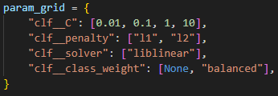
Detailed Progress
Grid Search
Compare Versions
Holdout
Holdout (GridSearch)
5-fold CV (fixed params)
5-fold CV (GridSearch)

Slide 16
Detailed Progress
Logistic Regression Results
Test Metrics : 793 [696 / 97]
Feature Set | Method | Accuracy | Precision | Recall | F1 | AUC
[age, bmi] | Holdout | .6595 | .2164 | .6804 | .3284 | .7144
 | 5-fold CV (fixed params) | .6595 | .2164 | .6804 | .3284 | .7144
 | Holdout (gridSearch) | .8789 | 1.0 | .0103 | .0204 | .7148
 | 5-fold CV (gridSearch) | .8777 |  |  |  | .7117
[age, bmi, bda] | Holdout | .6507 | .2097 | .6701 | .3194 | .7105
 | 5-fold CV (fixed params) | .6507 | .2097 | .6701 | .3194 | .7105
 | Holdout (gridSearch) | .8789 | 1.0 | .0103 | .0204 | .7118
 | 5-fold CV (gridSearch) | .8777 |  |  |  | .7148
[age, bmi, bdg] | Holdout | .6608 | .2171 | .6804 | .3292 | .7146
 | 5-fold CV (fixed params) | .6608 | .2171 | .6804 | .3292 | .7146
 | Holdout (gridSearch) | .8789 | 1.0 | .0103 | .0204 | .7118
 | 5-fold CV (gridSearch) | .8777 |  |  |  | .7148
[age, bmi, da] | Holdout | .6545 | .2117 | .6701 | .3218 | .7051
 | 5-fold CV (fixed params) | .6545 | .2117 | .6701 | .3218 | .7051
 | Holdout (gridSearch) | .8789 | 1.0 | .0103 | .0204 | .7118
 | 5-fold CV (gridSearch) | .8777 |  |  |  | .7056

Slide 17
Detailed Progress
Decision Threshold 조정
Logistic Regression Output이 확률이기 때문에, Threshold에 따라 최종 분류가 달라질 수 있을 거라고 판단
여러 Threshold를 비교 분석 진행

Slide 18
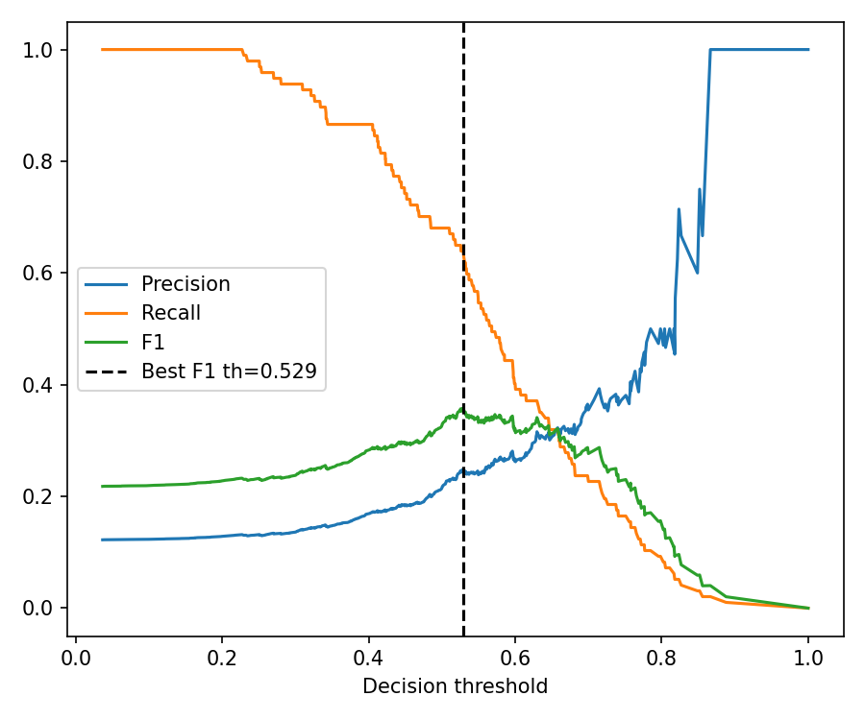
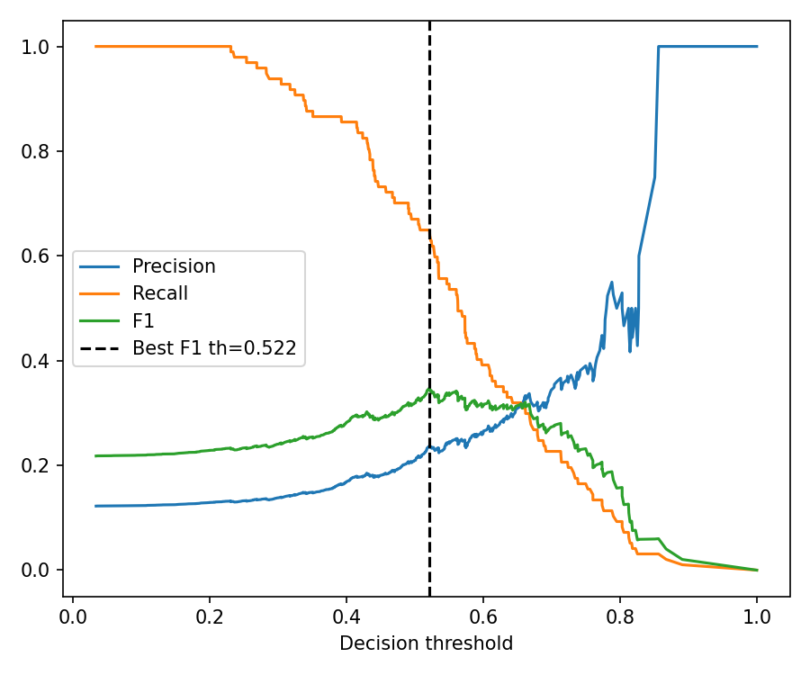
Detailed Progress
V1 [age, bmi]
V2 [age, bmi, bda]
Precision: 0.249
Recall: 0.639
F1: 0.358
Precision: 0.238
Recall: 0.649
F1: 0.348

Slide 19

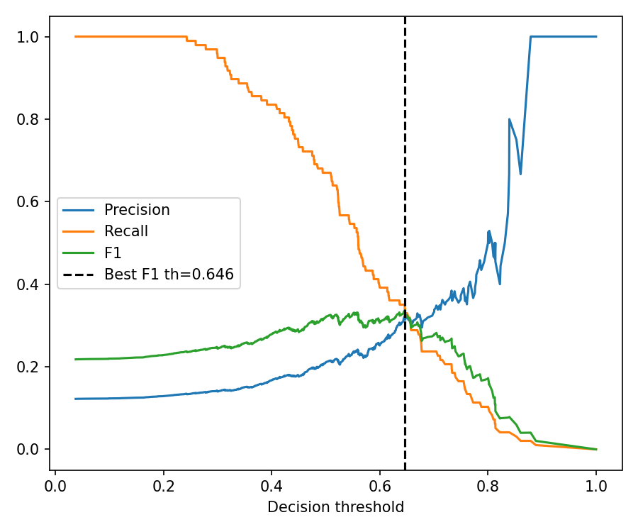
Detailed Progress
V3 [age, bmi, bdg]
V4 [age, bmi, da]
Precision: 0.249
Recall: 0.639
F1: 0.358
Precision: 0.324
Recall: 0.351
F1: 0.337

Slide 20
Detailed Progress
Stratified Analysis
Age : <60, 60~69, >=70
BMI : <18.5, 18.5~22.9, 23~24.9, >=25
Breast_Density_Grading : 1, 2, 3, 4

Slide 21
Detailed Progress
Logistic Regression Results
Test Metrics : 793 [696 / 97]
Feature Set | Stratified Variable | Method | N | Accuracy | Precision | Recall | F1 | AUC
[age, bmi] | Age | <60 | 417 | .8201 | .1719 | .3333 | .2268 | .6628
 |  | 60-69 | 276 | .5543 | .2282 | .8095 | .3560 | .7126
 |  | >=70 | 100 | .2800 | .2283 | .9545 | .3684 | .6696
 | BMI | <18.5 | 36 | .4444 | .3667 | .9167 | .5238 | .5729
 |  | 18.5-22.9 | 378 | .5582 | .2083 | .7273 | .3239 | .6748
 |  | 23-24.9 | 197 | .7766 | .1957 | .5625 | .2903 | .6708
 |  | >=25 | 182 | .7857 | .1622 | .4286 | .2353 | .7085
[age, bmi, bda] | Age | <60 | 417 | .8153 | .1562 | .3030 | .2062 | .6647
 |  | 60-69 | 276 | .5362 | .2208 | .8095 | .3469 | .7070
 |  | >=70 | 100 | .2800 | .2283 | .9545 | .3684 | .6696
 | BMI | <18.5 | 36 | .4444 | .3571 | .8333 | .0500 | .5764
 |  | 18.5-22.9 | 378 | .5423 | .2020 | .7273 | .3162 | .6730
 |  | 23-24.9 | 197 | .7716 | .1915 | .5625 | .2857 | .6744
 |  | >=25 | 182 | .7857 | .1622 | .4286 | .2353 | .7015

Slide 22
Detailed Progress
Logistic Regression Results
Test Metrics : 793 [696 / 97]
Feature Set | Stratified Variable | Method | N | Accuracy | Precision | Recall | F1 | AUC
[age, bmi, bdg] | Age | <60 | 417 | .8225 | .1746 | .3333 | .2292 | .6634
 |  | 60-69 | 276 | .5543 | .2282 | .8095 | .3560 | .7129
 |  | >=70 | 100 | .2800 | .2283 | .9545 | .3684 | .6684
 | BMI | <18.5 | 36 | .4444 | .3667 | .9167 | .5238 | .5729
 |  | 18.5-22.9 | 378 | .5608 | .2094 | .7273 | .3252 | .6755
 |  | 23-24.9 | 197 | .7766 | .1957 | .5625 | .2903 | .6721
 |  | >=25 | 182 | .7857 | .1622 | .4286 | .2353 | .7077
 | BDG | 1 | 54 | .7222 | .2143 | .4286 | .2857 | .6413
 |  | 2 | 89 | .6180 | .2979 | .9333 | .4516 | .8428
 |  | 3 | 540 | .6537 | .1850 | .6066 | .2835 | .6752
 |  | 4 | 110 | .7000 | .2791 | .8571 | .4211 | .7984
[age, bmi, da] | Age | <60 | 417 | .8106 | .1714 | .3636 | .2330 | .6669
 |  | 60-69 | 276 | .5507 | .2230 | .7857 | .3474 | .7010
 |  | >=70 | 100 | .2900 | .2247 | .9091 | .3604 | .6358
 | BMI | <18.5 | 36 | .3889 | .3438 | .9167 | .5000 | .5625
 |  | 18.5-22.9 | 378 | .5450 | .2030 | .7273 | .3175 | .6705
 |  | 23-24.9 | 197 | .7817 | .1860 | .5000 | .2712 | .6671
 |  | >=25 | 182 | .7967 | .1714 | .4286 | .2449 | .7020

Slide 23
FeedBack
1. “Precision 1.0 / Recall 0.01”의 원인 규명이 최우선 (연구 진행 中)
Decision Threshold 분석
SMOTE 후 데이터 분포 변화 검증
class_weight 영향 분석
오분류 샘플(FN/FP) 분석
GridSearch 구간과 Holdout 테스트셋의 분포 차이 검증

Slide 24


